Slide 1

Address –
984, Bhawani Peth,
Near A.d Camp chowk,
Pune 411002.

Slide 2
Personal Details
Name – Sufiyan Salim Memon
Qualification – BBA (Accounting & Finance)
Symbiosis Centre for Management Studies
Groups affiliated with
    Chrysalis Entrepreneurs’ Forum
    Cutchi Memon Organisation
    Poona Iron & Steel Merchants’ Association

Slide 3
Products – Mild Steel
We deal in everything related to Mild Steel
  MS Pipes
  MS Angles/Channels/Beams
  Sheets (HR/CR/GP)
  Plates
  TMT bars
  Colour coated sheets
  Steel Coils

Slide 4






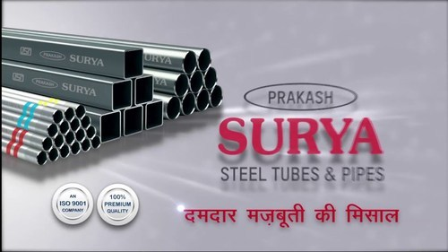

Products - Pipes

Slide 5
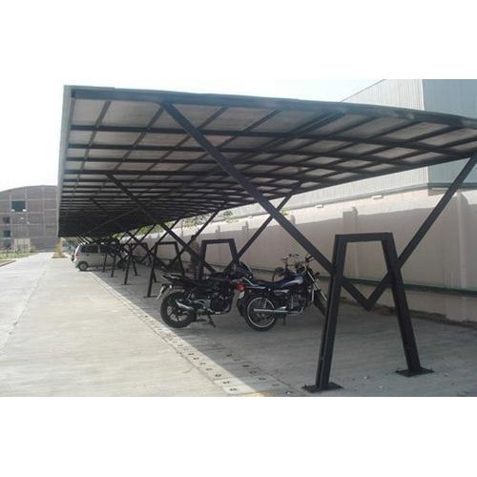
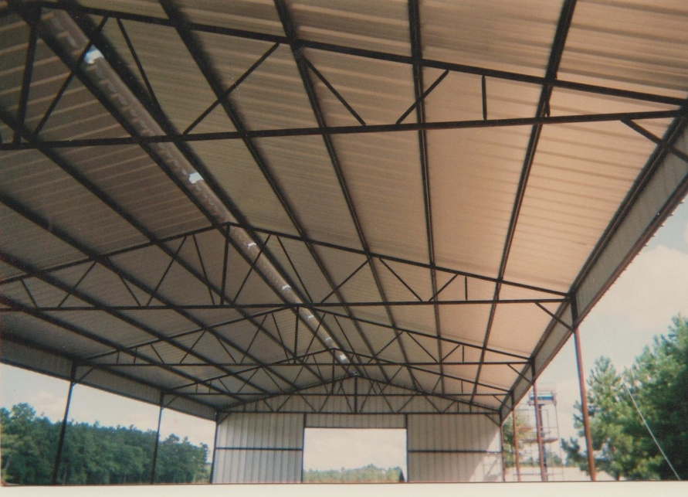
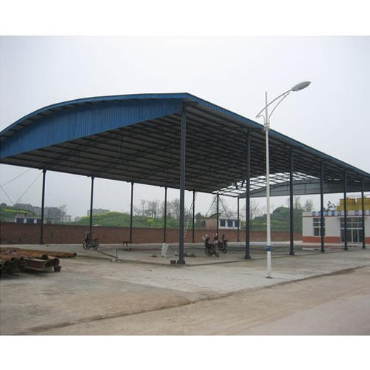
Applications – Pipes
Steel Structural Sheds

Slide 6
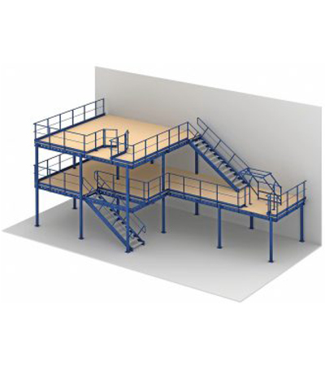
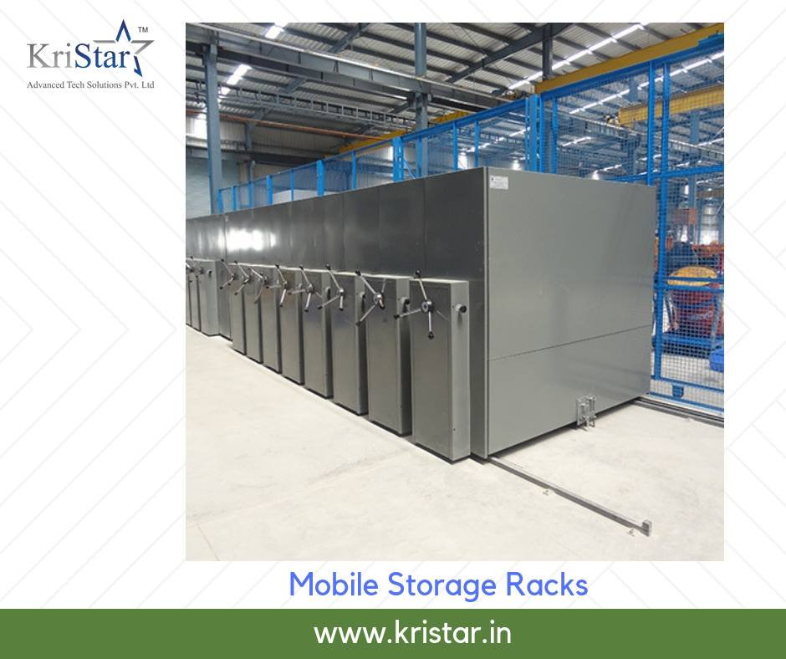
Applications – Pipes
Frames & Racks

Slide 7
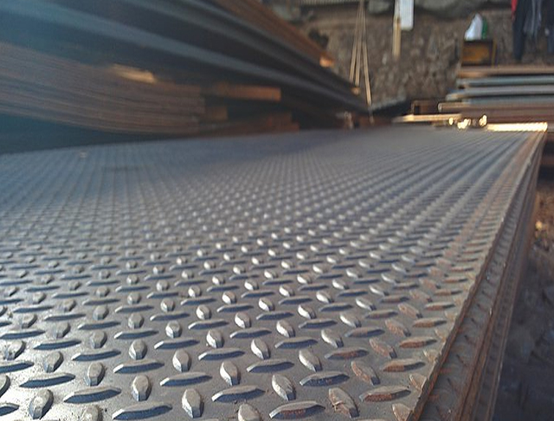
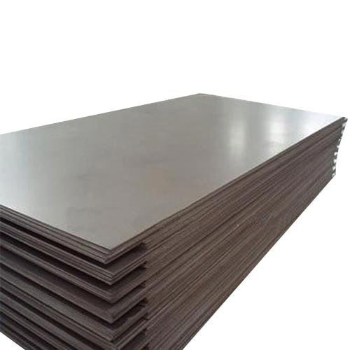
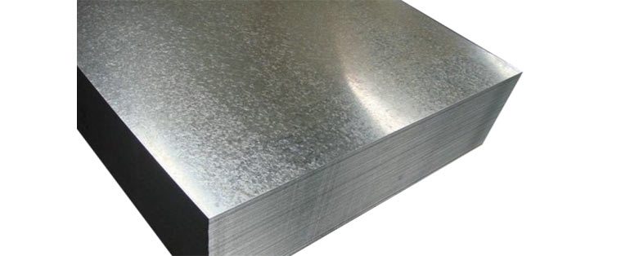
Products – Sheets/Plates

Slide 8
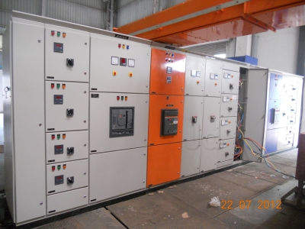
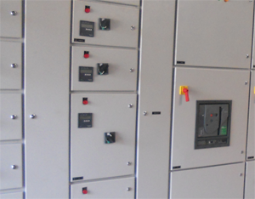
Applications– Sheet/Plates
Control Panels

Slide 9
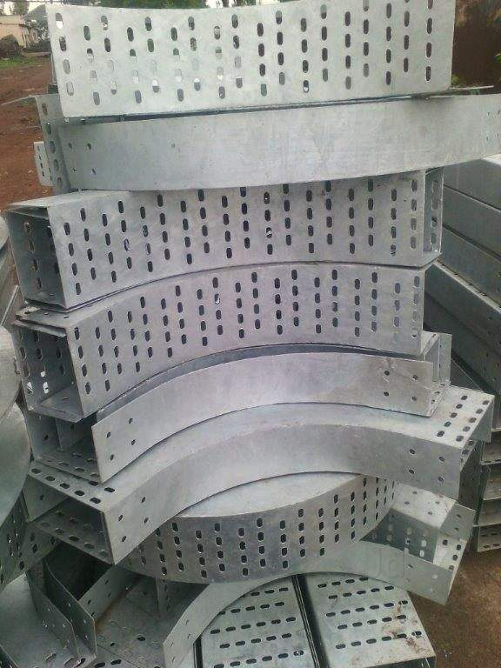
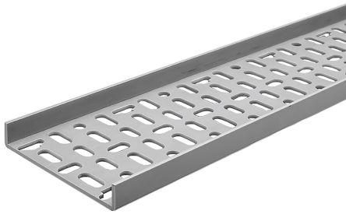
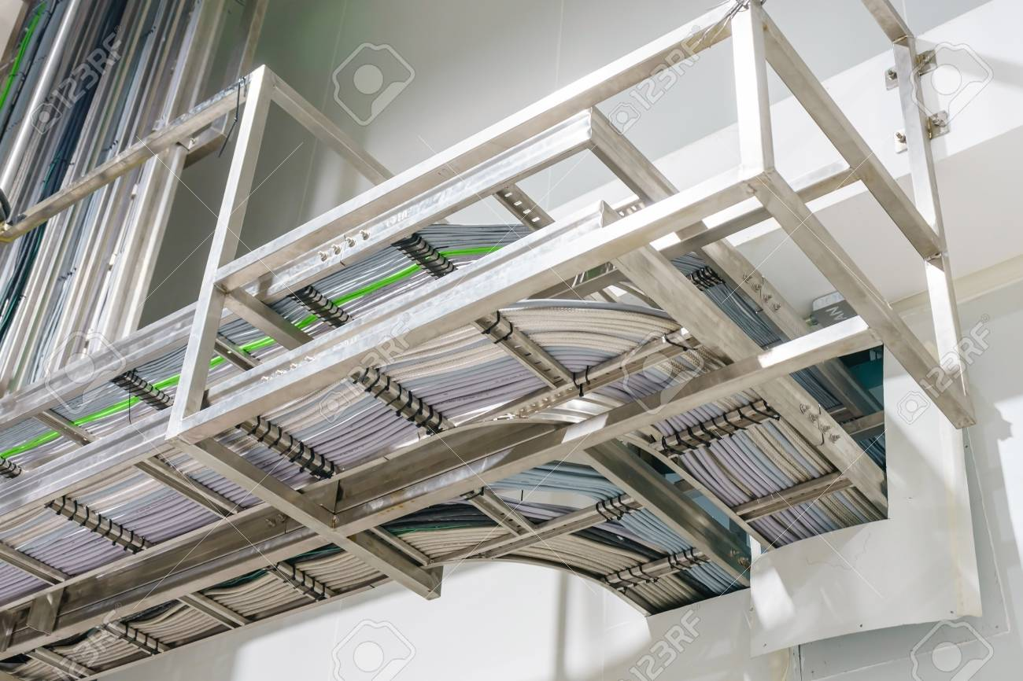
Applications– Sheet/Plates
Cable Tray

Slide 10
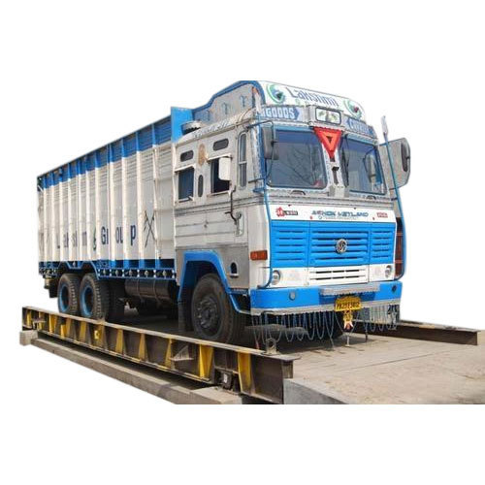
Applications– Sheet/Plates
Weigh Bridge

Slide 11
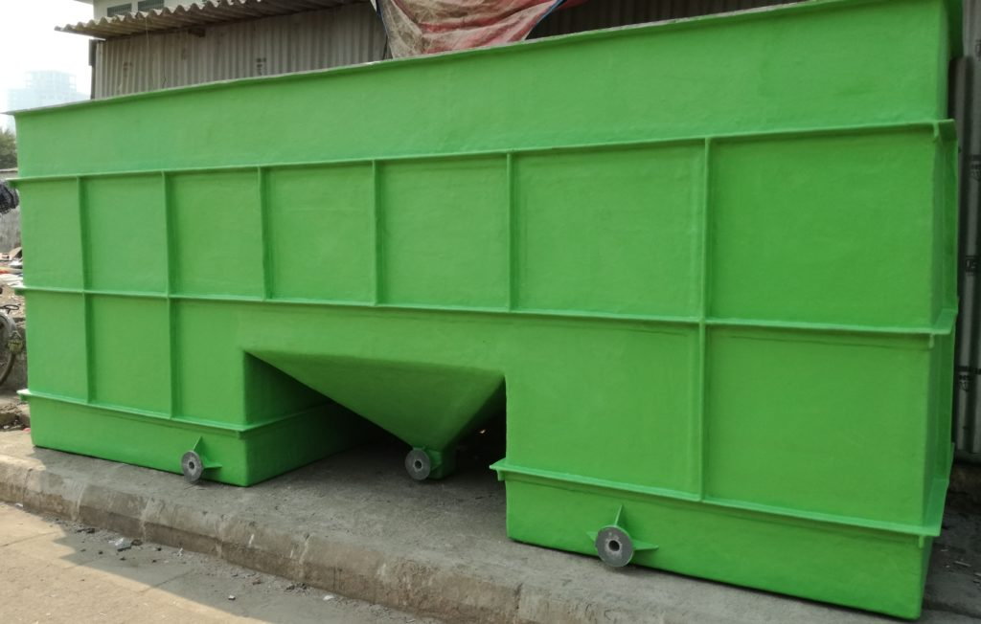
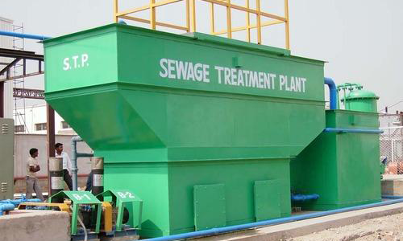
Applications – Sheets/Plates
Waste Water Management plant

Slide 12







Products – TMT bars

Slide 13
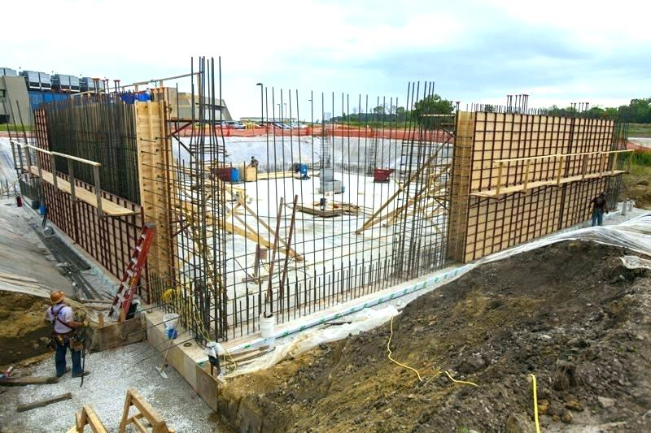
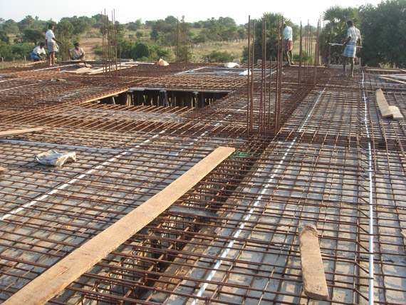
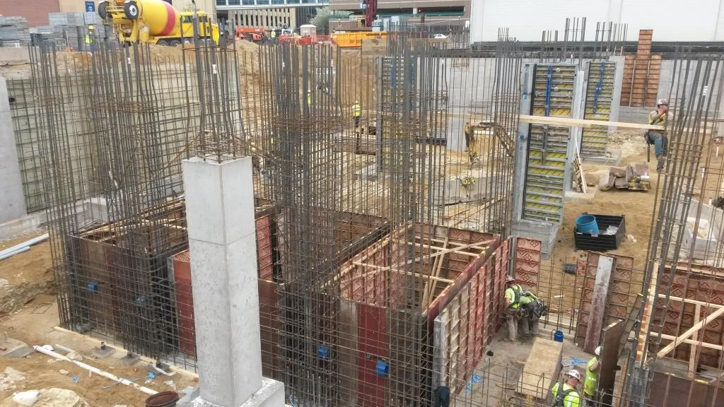
Applications – TMT Bar
Construction

Slide 14


Products – Colour Coated Sheet
Used for roofing/partitions

Slide 15
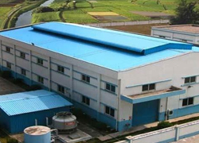
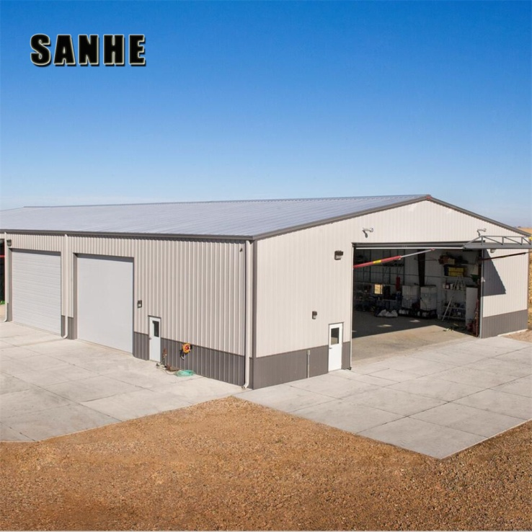
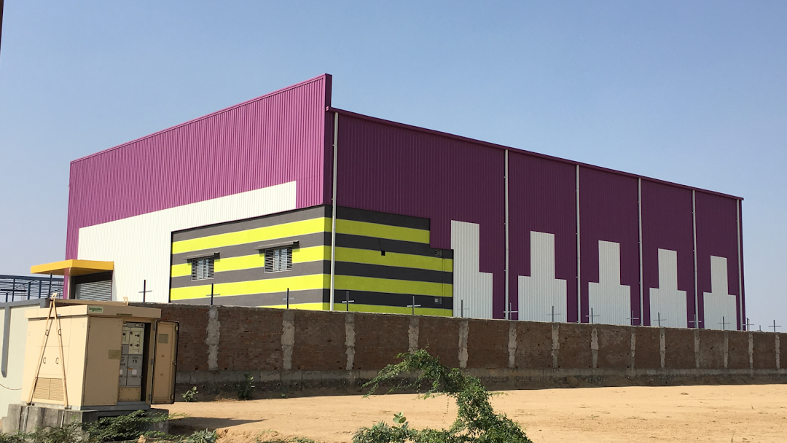
Applicaions – Colour Coated Sheets

Slide 16
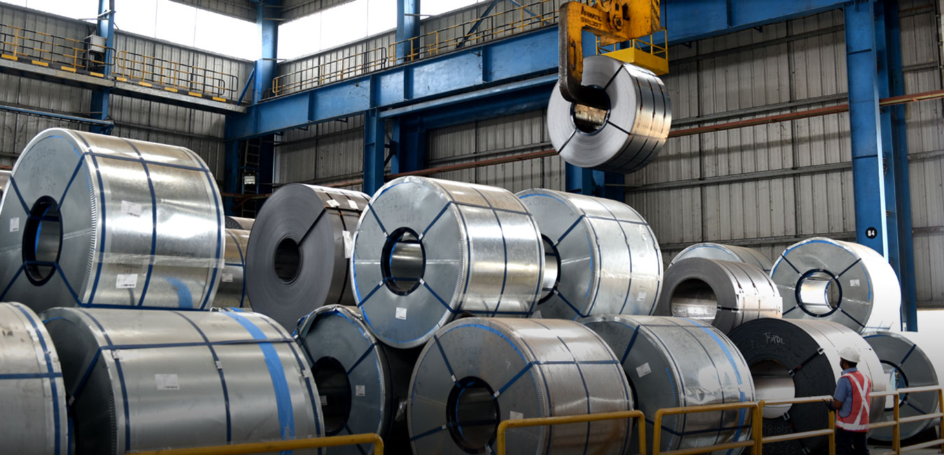
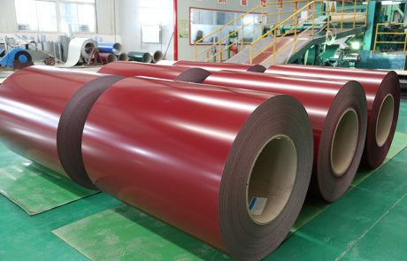
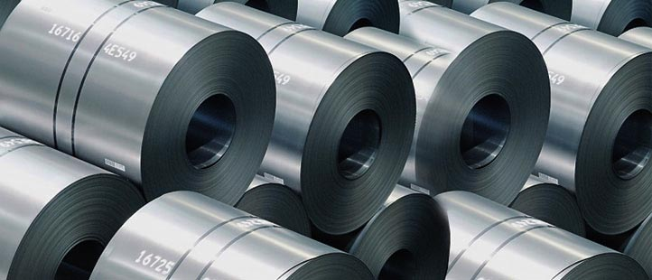
Products – Steel Coils
HR/CR/GP/Colour Coated

Slide 17

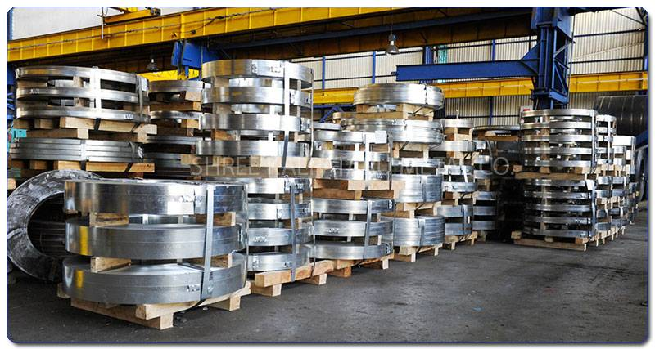
Applications – Steel Coils
Slit Coils

Slide 18
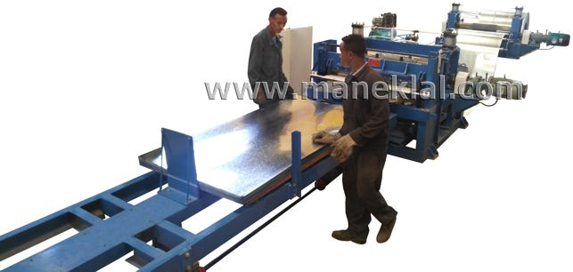
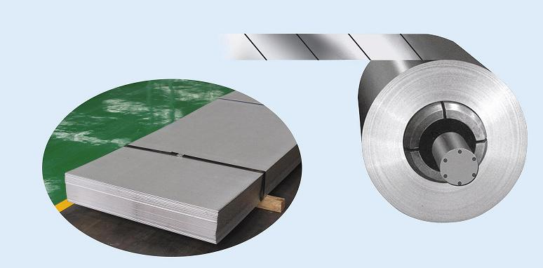
Applications – Steel Coils
Sheet Manufacturing

Slide 19
Why Steel House?
35 years of expertise in trading
Widest range of products and brands in the market
Trusted all over India
Great co-ordinating staff
Delivery of steel all over Maharashtra, Madhya Pradesh and Gujarat from he closest vendor/dealer
Customer centric approach

Slide 20













Gives

Slide 21







Gives

Slide 22
Thank you!
Iron Man of Harmony

